Slide 1
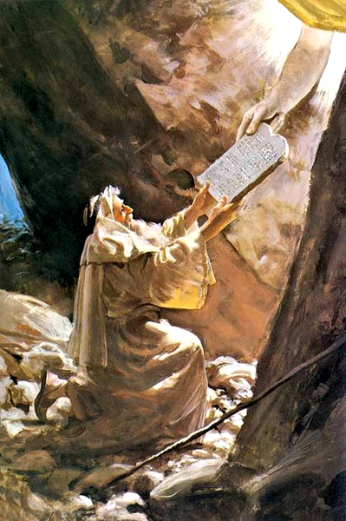
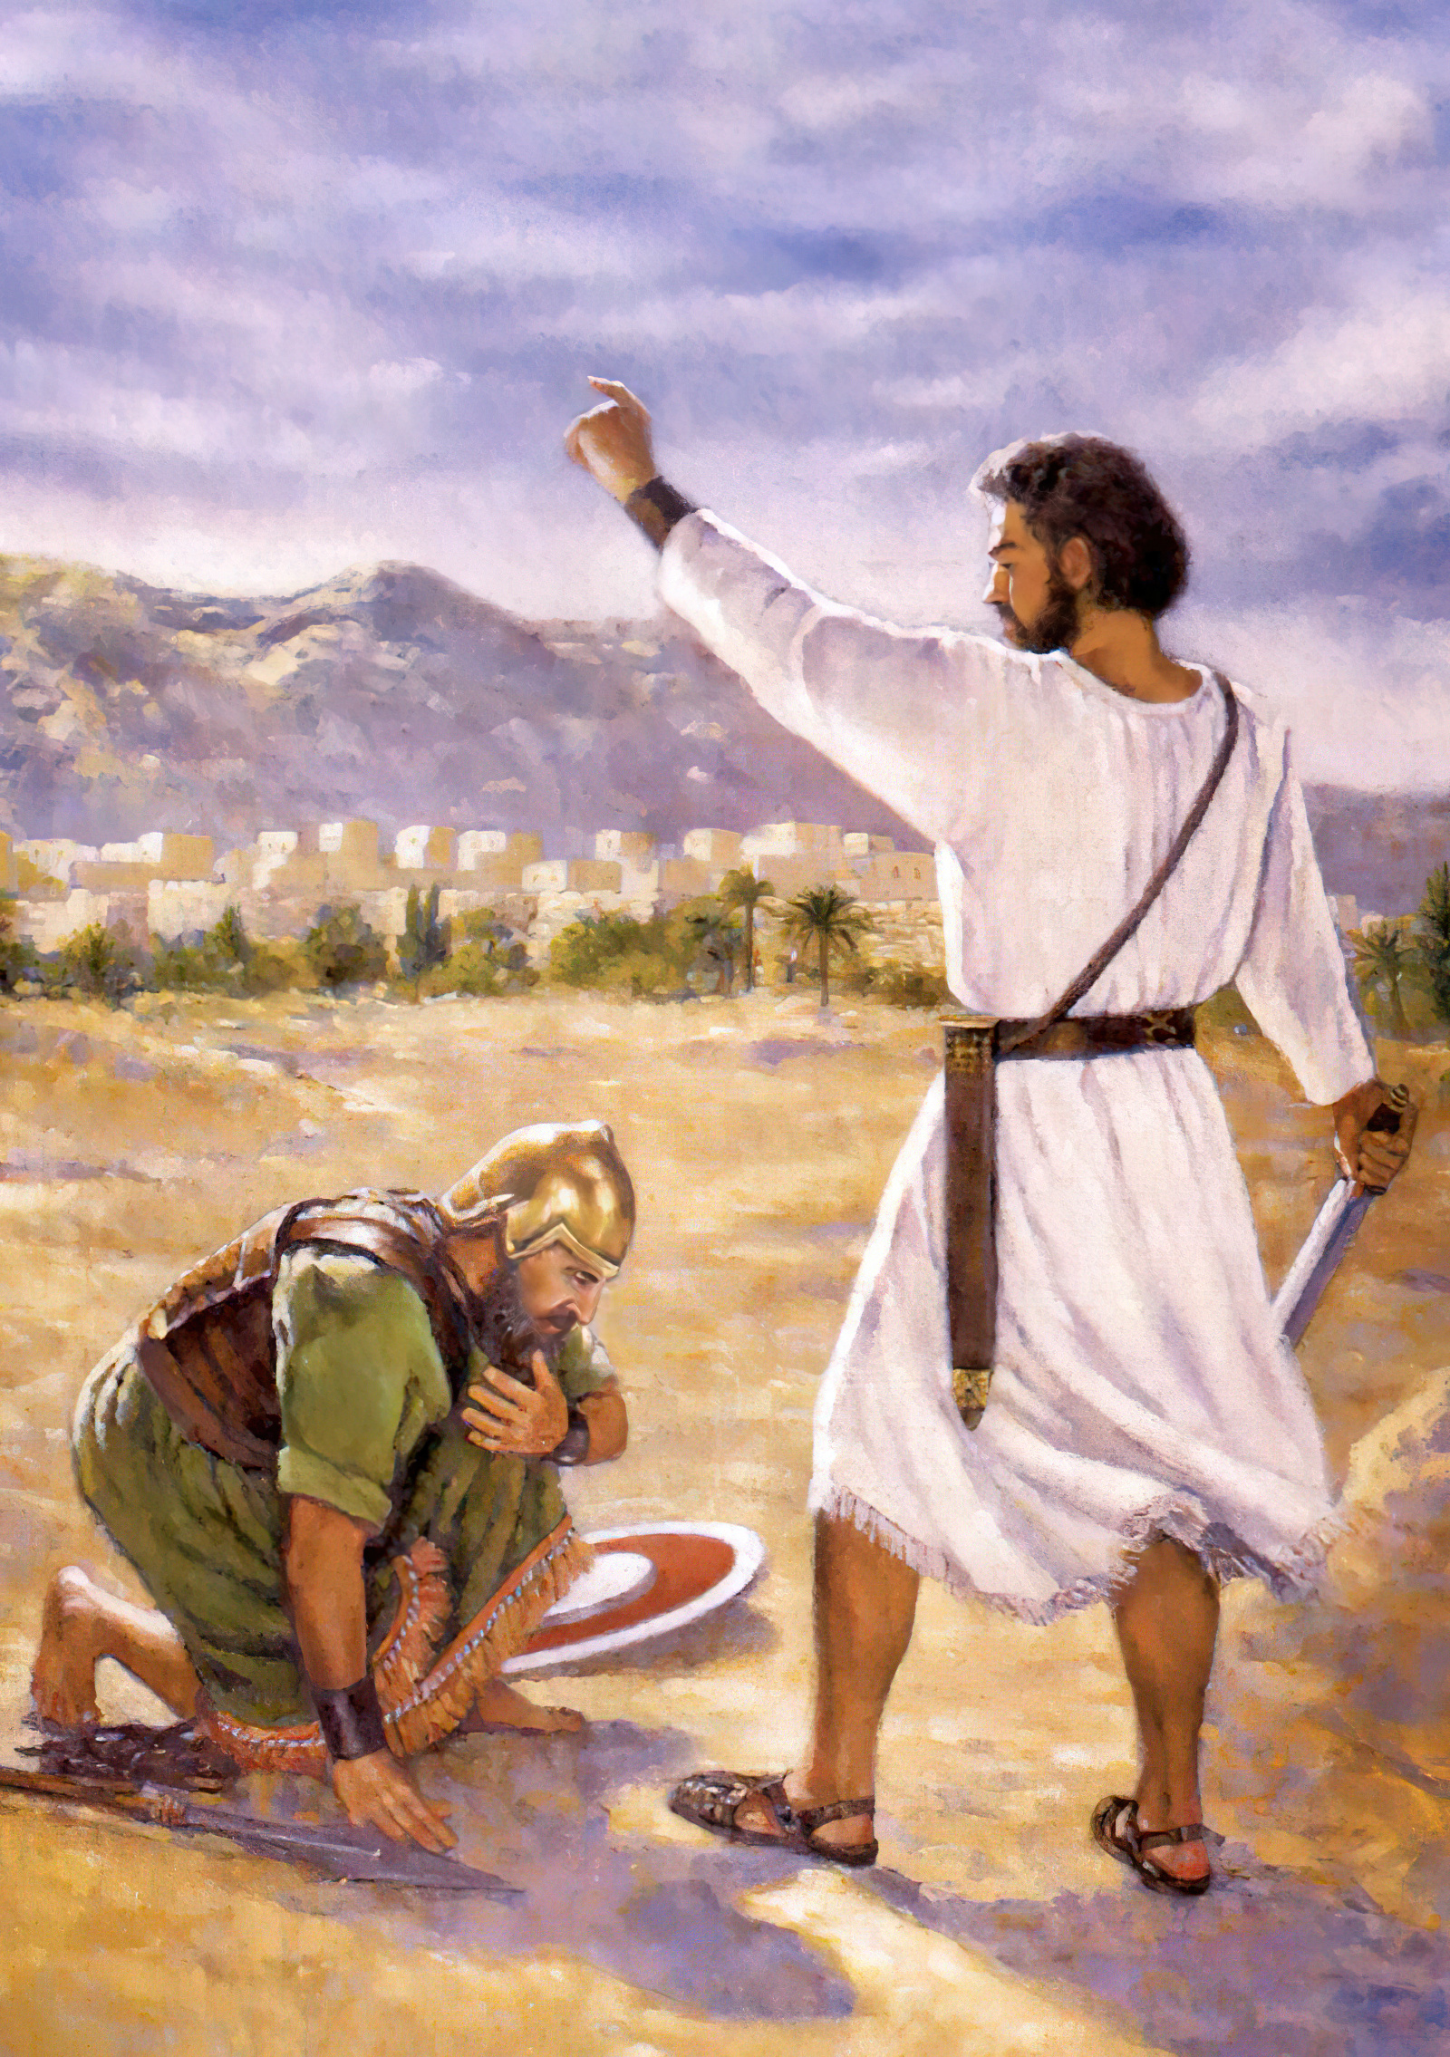
Mosese mo Sosiua

Slide 2
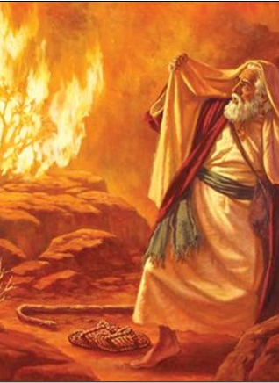
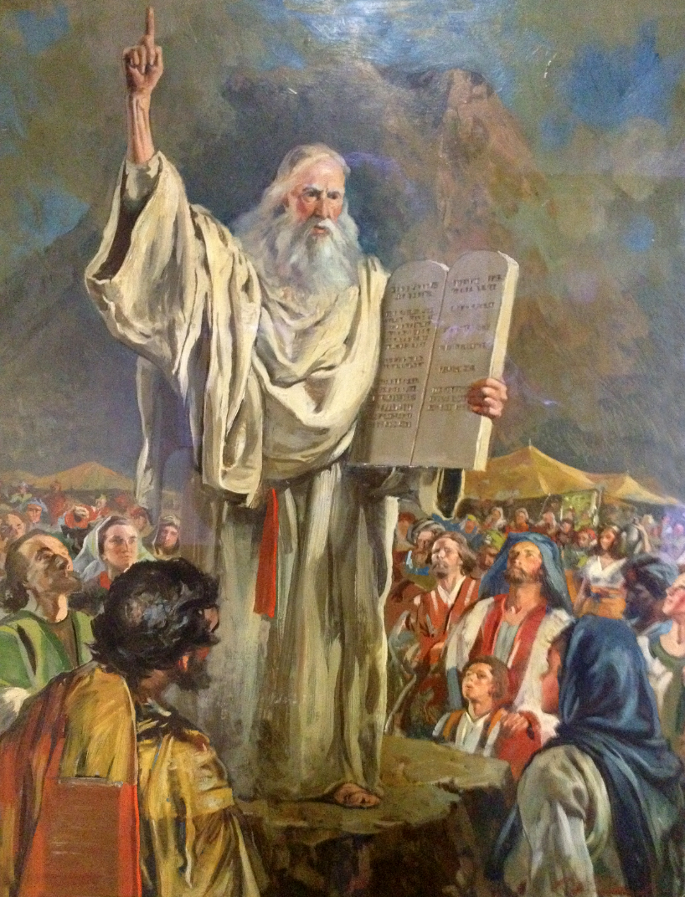
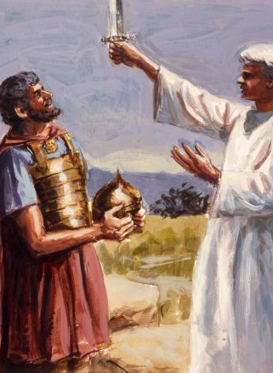
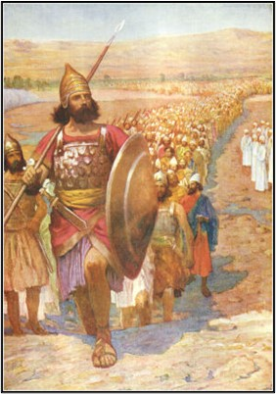
Naʻe fili ʻe he ʻOtua ʻa Mosese mo Sosiua ke na taki ʻa e kakai ʻo ʻIsileli ʻi ha toʻu tangata hokohoko ʻe ua, ʻi ha ngaahi momeniti mahuʻinga ʻi hona hisitolia.
ʻOku lava ke tau sio ki he ngaahi faitatau lahi ʻi he founga naʻe ngaue ai ʻa e ʻOtua mo kinautolu. ʻI he ngaahi meʻa faitatau ko ʻeni, te tau lava foki ʻo sio ki he founga ʻoku ngaue ai ʻa e ʻOtua mo kitautolu.

Slide 3

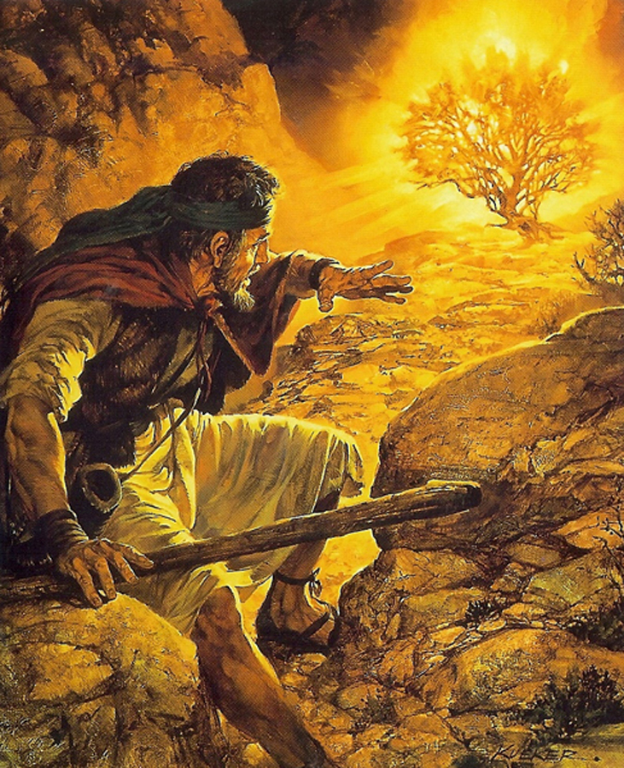

ʻOku ha ʻa e ʻOtua kiate Kinautolu
Kia Sosiua ko ha tangata tau mo ha heleta unuhi.
Sosiua 5:13-14
Kia Mosese ʻi ha ulo ʻo e afi ʻi he lotolotonga ʻo ha ʻakau. ʻEkesotosi 3:2-3

Slide 4
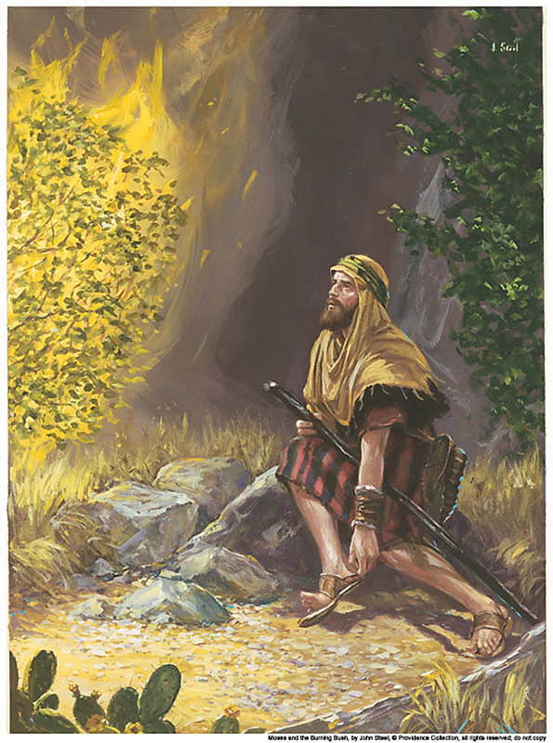
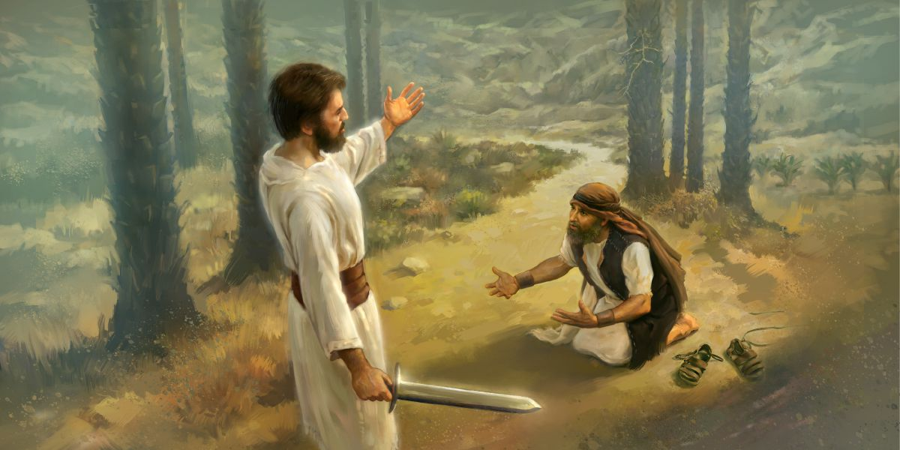
“Pea naʻe ʻafioʻi ʻe Sihova ki heʻene afe ke mamata, pea folofola ʻae ʻOtua kiate ia mei he lotolotonga ʻoe ʻuluʻakau, ʻo pehē, “Mōsese, Mōsese.” Pea pehē ʻe ia, “Ko au eni.” 5 Pea pehē ʻe ia, ‘ʻOua naʻa ke ofi mai ki heni; toʻo ho topuvaʻe mei ho vaʻe, he ko e potu ʻoku ke tuʻu ai ko e kelekele tapu.”Ekisotosi 3:4-5
“Pea pehē ʻe he ʻEiki tau ʻoe tau ʻa Sihova kia Siosiua, “Vete ho topuvaʻe mei ho vaʻe; he ko e potu ʻoku ke tuʻu ai, ko e potu māʻoniʻoni. Pea naʻe fai ia ʻe Siosiua.”.” Sosiua 5:15
Naʻa ne fekauʻi kinautolu ke nau vete ʻa e suu mei honau vaʻe koeʻuhi he naʻe toputapu ʻa e feituʻu

Slide 5
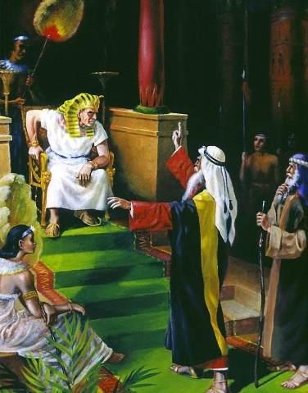
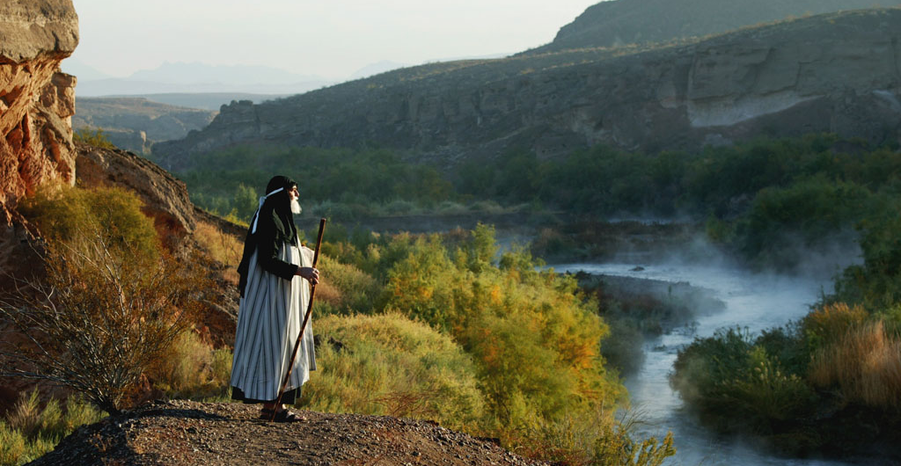
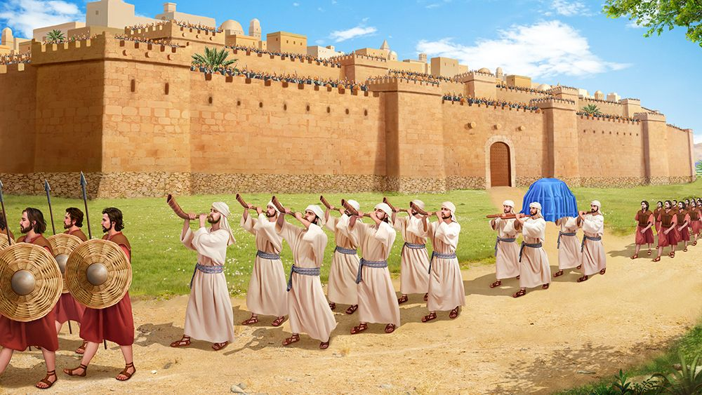
Kimuʻa aí naʻá ne ʻoange kia Siosiua ʻa e misiona kakató: “Pea naʻe folofola ʻa Sihova kia Siosiua, “Vakai, Kuo u tuku ʻa Seliko ki ho nima, mo hono tuʻi, mo e kau tangata toʻa ʻo ia. Pea ko kimoutolu ʻae kau tangata tau kotoa pē, te mou ʻāʻi ʻae kolo, ʻo ʻalu ʻo takatakai ʻo tuʻo taha. Pea ke fai pehē pe ʻi he ʻaho ʻe ono. Pea ʻe fua ʻe he taulaʻeiki ʻe toko fitu ʻi he ʻao ʻoe puha ʻoe fuakava ʻae meʻalea ʻe fitu, ko e nifo ʻoe sipitangata: pea ʻi hono fitu ʻoe ʻaho te mou ʻalu fakatakamilo ʻi he kolo ke liunga fitu, pea ʻe ifi ʻe he kau taulaʻeiki ʻae meʻalea. Pea ʻe hoko ʻo pehē, ʻoka nau ka ifi fakamānavaloloaʻaki ʻae meʻalea ko e nifo ʻoe sipitangata, pea ka mou ka ongoʻi ʻae longoaʻa ʻoe meʻalea, ʻe kaila ʻe he kakai kotoa pē ʻi he fuʻu kaila lahi; pea ʻe hinga lafalafa ai ʻae ʻā ʻoe kolo, pea ʻe ʻalu hake fakahangatonu atu ki ai ʻae tangata kotoa pē.” Sosiua 6:2-5
ʻOku ʻOange ha Misiona Kiate Kinautolu .
ʻOkú Ne ʻoange kia Mōsese ʻa e misiona ko ʻení:Pea ko eni, ke ke haʻu, pea te u fekau koe kia Felo, koeʻuhi ke ke ʻomi hoku kakai ko e fānau ʻa ʻIsileli mei ʻIsipite.”
Ekisotosi 3:10

Slide 6

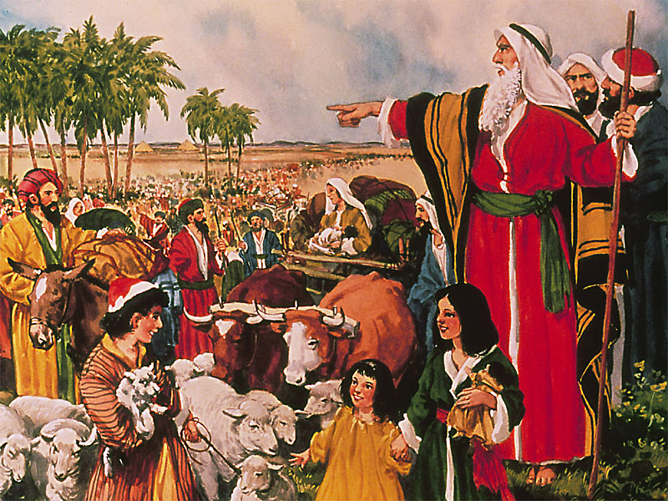
ʻOku Palomesi ʻa e ʻOtuá Te Ne ʻiate Kinautolu .
“‌ʻE ʻikai ha tangata te ne faʻa tuʻu ʻi ho ʻao, ʻi he ngaahi ʻaho kotoa pē ʻo hoʻo moʻui: ʻo hangē ko ʻeku ʻia Mōsese, ʻe pehē pe ʻeku ʻiate koe: ʻe ʻikai te u fakatukutukuʻi koe, pe siʻaki koe” Sosiua 1:5
"Pea naʻe pehe ʻe ia, Naʻa ku ʻia Mosese, pea te u ʻiate koe" ʻEkesotosi 3:12

Slide 7
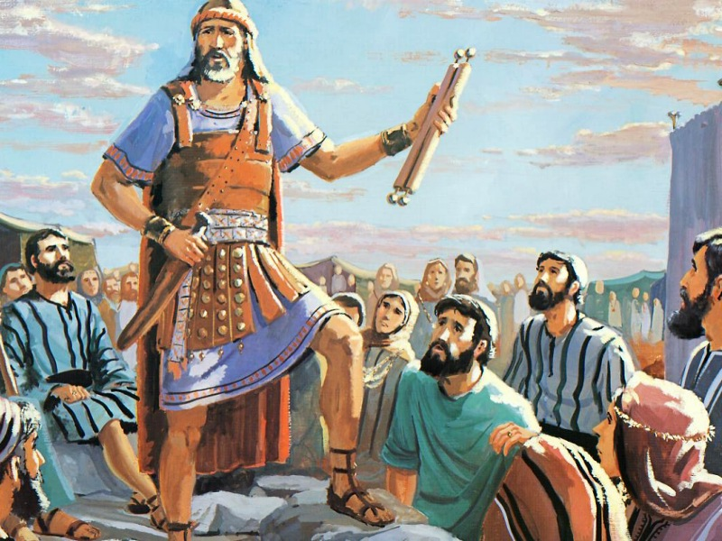
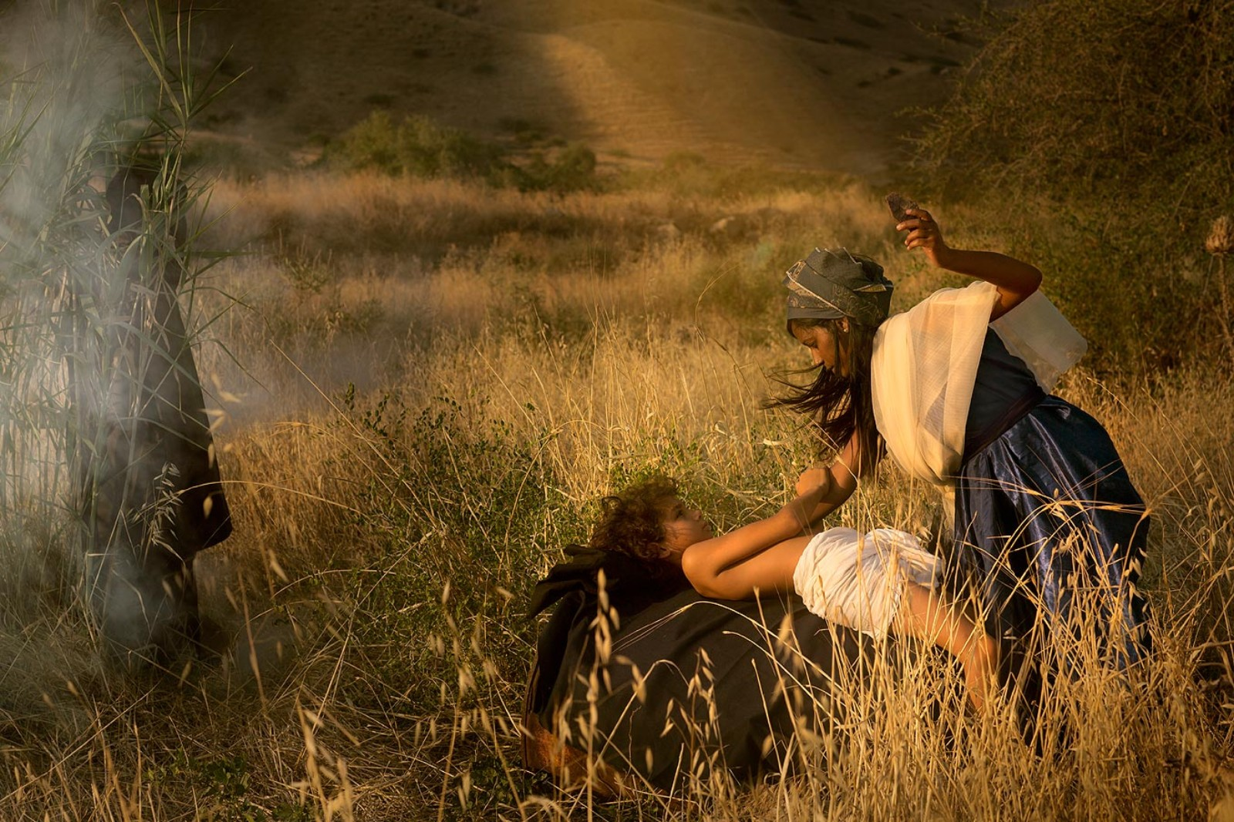
Naʻe pau ke Fai ʻa e Kamu ko ha Fakaʻilonga ʻo e Fuakava mo e ʻOtua
“Pea naʻe hoko ʻo pehē ʻi he hala ʻi he fale talifononga, naʻe fakafetaulaki ʻa Sihova kiate ia, ko e kumi ke tāmateʻi ia. 25 Pea naʻe toʻo ai ʻe Sipola ʻae maka māsila, ʻo ne kamuʻi ʻene tama, ʻo ne si ia ki hono vaʻe, ʻo ne pehē, “Ko e moʻoni ko e mali pani toto koe kiate au.”.” Ekisotosi 4:24-25
“Pea ʻi he kuonga ko ia naʻe folofola ʻa Sihova kia Siosiua, “Ngaohi maʻau ʻae ngaahi hele māsila, pea toe kamuʻi ʻae fānau ʻa ʻIsileli ko hono liunga ua.” 3 Pea naʻe ngaohi ʻe Siosiua ʻae ngaahi hele māsila, ʻo ne kamuʻi ʻae fānau ʻa ʻIsileli, ʻi Kipahalaloti.”
Sosiua 5:2-3

Slide 8
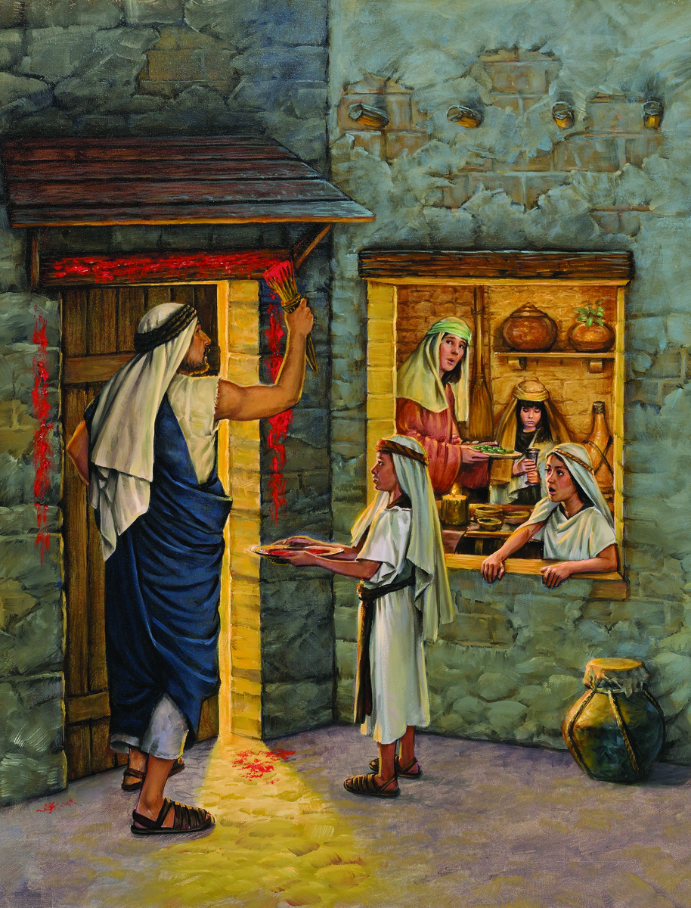
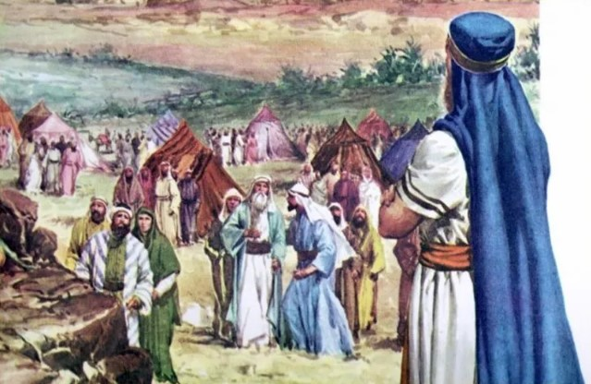
Naʻa nau Katoangaʻi ʻa e Lakaatu
“Pea naʻe ʻapitanga ʻae fānau ʻa ʻIsileli ʻi Kilikali, ʻonau fai ʻa e kātoanga ʻoe Lakaatu ʻi hono hongofulu ma fā ʻoe ʻaho ʻoe māhina ʻi he efiafi ʻi he ngaahi tafangafanga ʻo Seliko. .” Sosiua 5:10
“Pea naʻe toki fekau ʻe Mōsese ke haʻu ʻae kau mātuʻa kotoa pē ʻo ʻIsileli, ʻo ne pehē kiate kinautolu, “Vaheʻi ʻo toʻo kiate kimoutolu ʻae lami ʻo fakatatau ki homou ngaahi kau nofoʻanga ʻo tāmateʻi ʻae Lakaatu. Pea te mou toʻo ʻae ʻū ʻisope ʻo unu ia ki he toto ʻoku ʻi he ipu, ʻo vali ʻae potu fakalava mo e pou ʻe ua ʻoe matapā ʻaki ʻae toto ʻaia ʻoku ʻi he ipu; pea ʻe ʻikai ʻalu ha tokotaha ʻi he matapā ʻo hono fale kituaʻā kaeʻoua ke pongipongi hake. Koeʻuhi ʻe hāʻele atu ʻa Sihova ke taaʻi ʻae kakai ʻIsipite: pea ka ʻafio ia ki he toto ʻi he potu fakalava mo e pou ʻe ua, ʻe Lakaatu ʻa Sihova ʻi he matapā, pea ʻe ʻikai te ne tuku ʻae fakaʻauha ke hū ki homou fale ke taaʻi ʻakimoutolu.” Ekisotosi 12:21-23

Slide 9
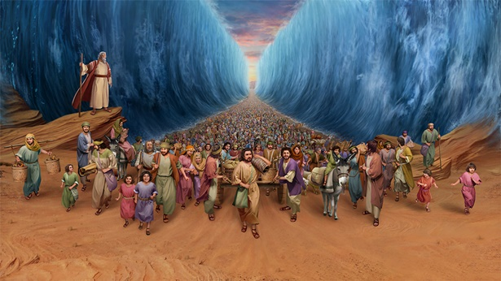
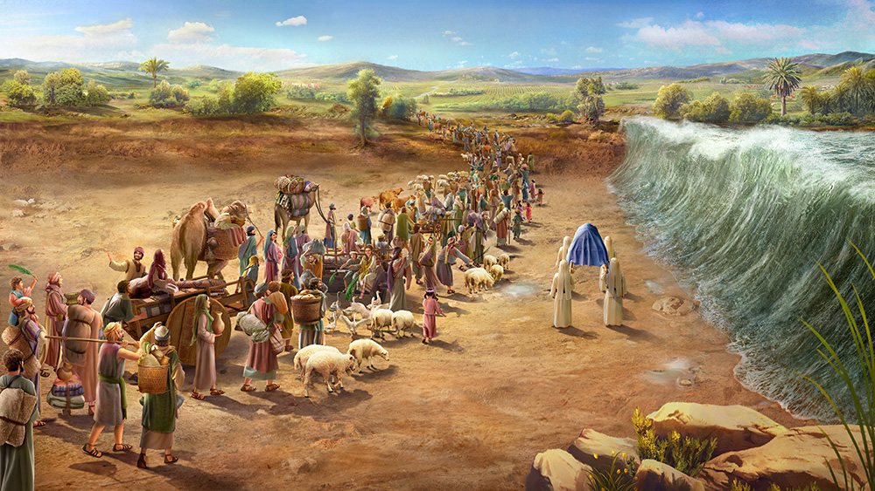
Naʻa nau Fou Momoa ʻi he Tahi mo e Vaitafe
“Pea naʻe mafao atu ʻae nima ʻo Mōsese ki tahi; pea naʻe pule ʻa Sihova ke foki ʻae tahi ʻi he matangi mālohi mei hahake, ʻi he pō kotoa ko ia, ʻo ne ngaohi ʻae tahi ke mōmoa, pea naʻe vaeua ʻae ngaahi vai. Pea naʻe ʻalu mōmoa ʻae fānau ʻa ʻIsileli ʻi he loto tahi: pea ko e ʻā kiate kinautolu ʻae vai ʻi he nima toʻomataʻu, mo e nima toʻohema.” Ekisotosi 14:21-22
“Pea naʻe pehē, ʻi he hiki ʻae kakai mei honau ngaahi fale fehikitaki, ke ʻalu ki he kauvai ʻe taha ʻo Sioatani, naʻe ʻalu muʻomuʻa ʻae kau taulaʻeiki ʻi he ʻao ʻoe kakai, ʻo haʻamo ʻae puha ʻoe fuakava; Pea ʻi he hoko ki Sioatani ʻakinautolu naʻe haʻamo ʻae puha, pea tuʻu ki he veʻevai ʻae vaʻe ʻoe kau taulaʻeiki naʻe haʻamo ʻae puha, (he naʻe fonu mahakehake ʻa Sioatani, ʻi hono ngaahi ngutu vai kotoa pē ʻi he kuonga kotoa pē ʻoe ututaʻu,) ‌ʻIloange ko e ngaahi vai naʻe tafe mai naʻe tuʻu, pea tupu hake ʻo fakatafungofunga, ʻo vāmamaʻo ʻaupito mei he kolo ko ʻAtama, ʻaia ʻoku ʻi he potu ʻo Salitani: pea ko ia naʻe tafe mai ki he tahi ʻoe toafa, ʻaia ko e tahi kona, naʻe mamaha ia, pea motuhi: pea naʻe aʻa ai ʻae kakai ʻo hangatonu ki Seliko. Pea ko e kau taulaʻeiki ʻaia naʻe haʻamo ʻae puha ʻoe fuakava ʻo Sihova naʻe tuʻumaʻu ʻi he kelekele mōmoa ʻi loto Sioatani, pea naʻe ʻalu ʻae kakai ʻIsileli kotoa pē ʻi he kelekele mōmoa, ke ʻoua ke ʻosi ʻae kakai kotoa pē ki he kauvai ʻe taha ʻo Sioatani.” Sosiua 3:14-17

Slide 10
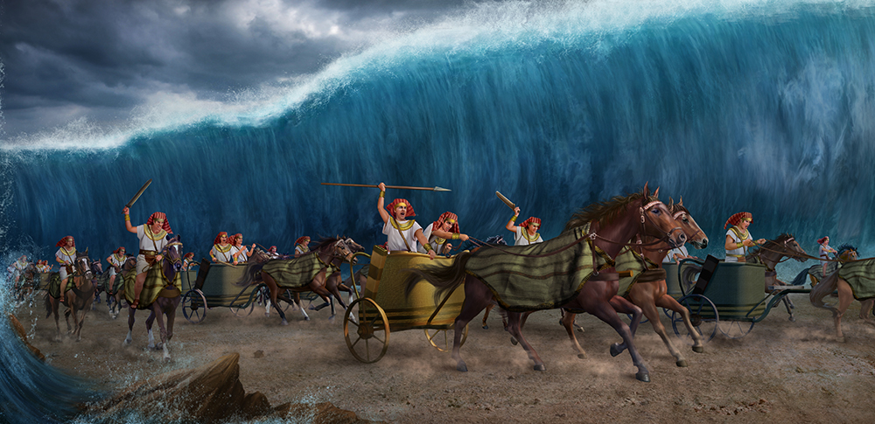
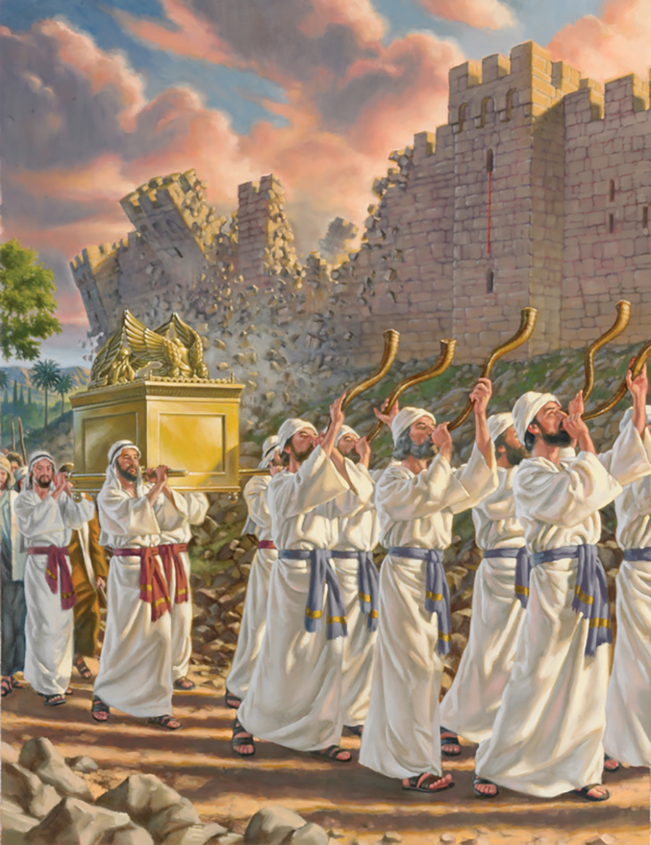
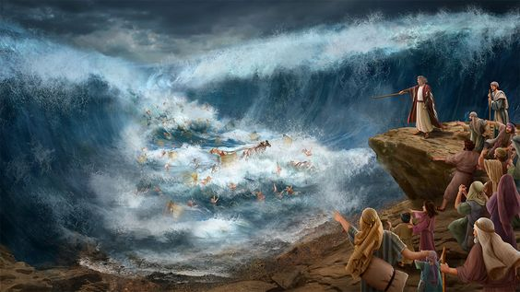
ʻOtua ʻo e Ngaahi Meʻa Fakaofo“He ko ia ia ʻoku ne faʻa fai ʻae ngaahi meʻa lahi mo taʻefaʻaʻilo;
ko e ngaahi meʻa fakaofo mo taʻefaʻalaua:”
(Siope 5:9)
“Pea pehē ʻe Mōsese ki he kakai, “ʻOua te mou manavahē, tuʻu fakalongolongo pe, ʻo mamata ki he fakamoʻui ʻa Sihova, ʻaia te ne fakahā kiate kimoutolu he ʻaho ni: he ko e kakai ʻIsipite kuo mou mamata ki ai he ʻaho ni, ʻe ʻikai te mou toe mamata ki ai ʻo lauikuonga. 14 ‌ʻE tau ʻa Sihova maʻamoutolu, pea te mou fakalongo pe.”
Ekisotosi 14:13
“Pea naʻe pehē ʻe Siosiua ki he kakai, “Fakamāʻoniʻoniʻi ʻakimoutolu: koeʻuhi ʻe fai ʻe Sihova ʻapongipongi ʻae ngaahi mana ʻiate kimoutolu.” Sosiua 3:5

Slide 11
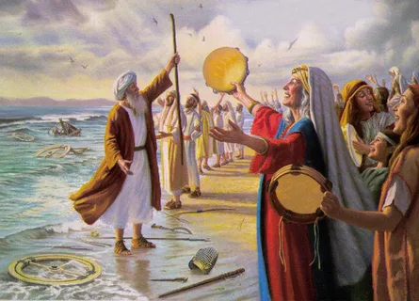
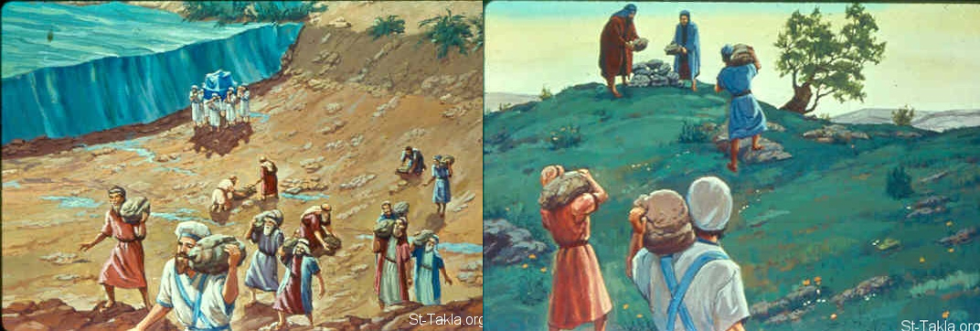
Naʻa nau fakamanatu ʻa e meʻa naʻe hoko ʻaki ha foʻi hiva mo ha maka fakamanatu
“Pea naʻe toki hiva ʻe Mōsese mo e fānau ʻa ʻIsileli ʻae hiva ni kia Sihova, ʻonau pehē,“Te u hiva kia Sihova, he kuo ne ikuna fakamanavahē: ko e hoosi mo ia ʻoku heka ai kuo ne lī ki loto tahi. Ko hoku mālohi mo ʻeku hiva ʻa Sihova,pea kuo hoko ia ko hoku fakamoʻui:ho hoku ʻOtua ia, pea teu teuteu moʻona ʻae fale nofoʻanga;ko e ʻOtua ia ʻo ʻeku tamai, pea te u fakahikihiki ia.” Ekisotosi 15:1-2
Koeʻuhi ke hoko ia ko e fakaʻilonga, ʻoka fehuʻi ʻe hoʻomou fānau ki heʻenau mātuʻa ʻamui, ʻo pehē, Ko e hā hono ʻuhinga ʻoe ngaahi maka ni? Pea te mou tala kiate kinautolu, naʻe motuhi ʻae vai ʻo Sioatani mei he ʻao ʻoe puha ʻoe fuakava ʻa Sihova; ʻi heʻene aʻa ʻi Sioatani, naʻe motu ua ʻae vai ʻo Sioatani: pea ko e ngaahi maka ni ko e meʻa fakamanatu tuʻumaʻu ki he fānau ʻa ʻIsileli ʻo taʻengata.” Sosiua 4:6-7

Slide 12
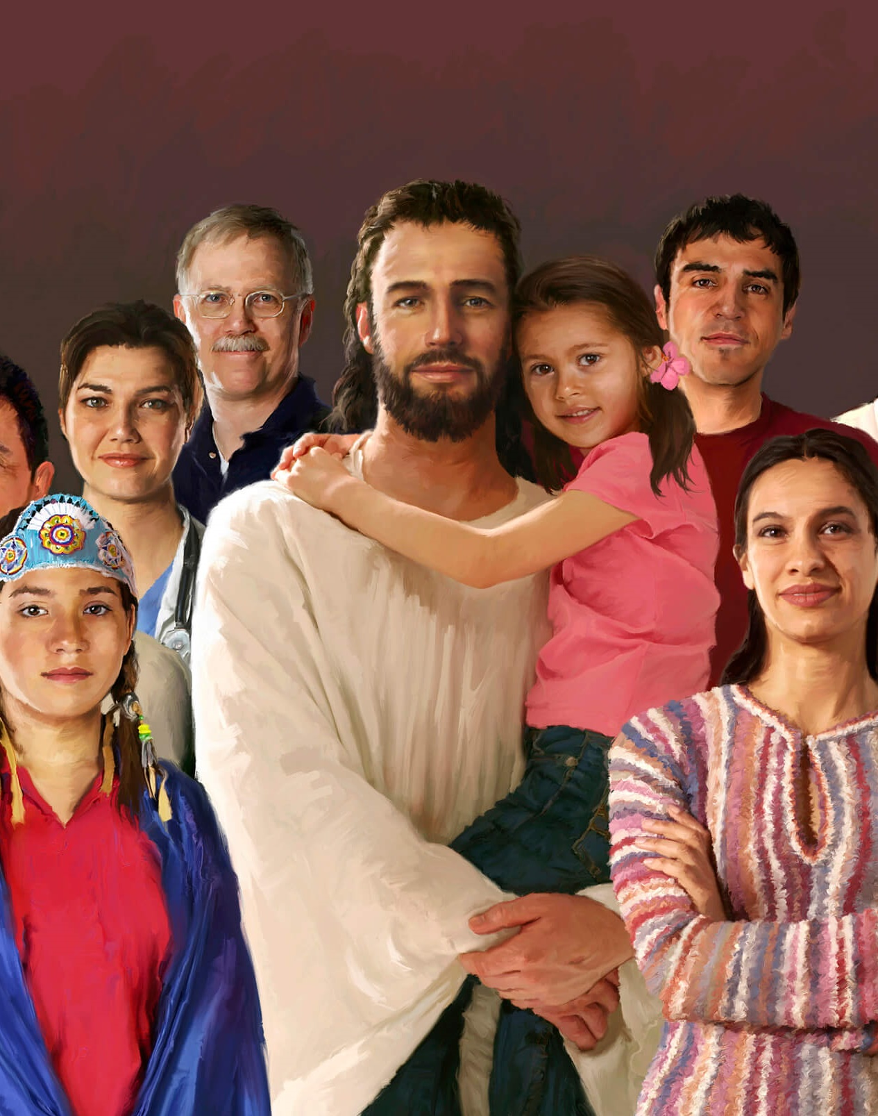









ʻOKU NGAUE FEFE ʻA E ʻOTUA MO KITAUTOLU?
ʻOku fakaha mai ʻe he ʻOtua Ia ki he tokotaha takitaha ʻo fktatau ki heʻetau fiemaʻu (Sosiua ko ha tangata tau te ne ikuna)
Ne fakahaaʻi mai kiate kitautolu ʻEne maʻoniʻoni,Hono ʻulungaanga ʻOku Ne ʻomi ha misiona kiate kitautolu
ʻOku Ne talaʻofa mai te Ne ʻiate kitautolu
ʻOku Ne kole mai ke kamu hotau loto
ʻOku tau tali ʻa e feilaulau fakalelei ʻa Sisuu
ʻOku tau laka atu ki muʻa ʻi he tui
ʻOku fakahoko ʻe he ʻOtua ʻa e ngaahi meʻa fakaofo
ʻOku tau fakafetaʻi kiate Ia
Te tau sio ki ha ngaahi meʻa ʻoku faitatau ai ʻa e ongo tangata ko ʻeni pea mo e founga naʻa nau maʻu fakataha ai mo e kakai ʻo ʻIsileli, ʻa e faingamalie ke fili ke tui pe ʻikai.

Slide 13
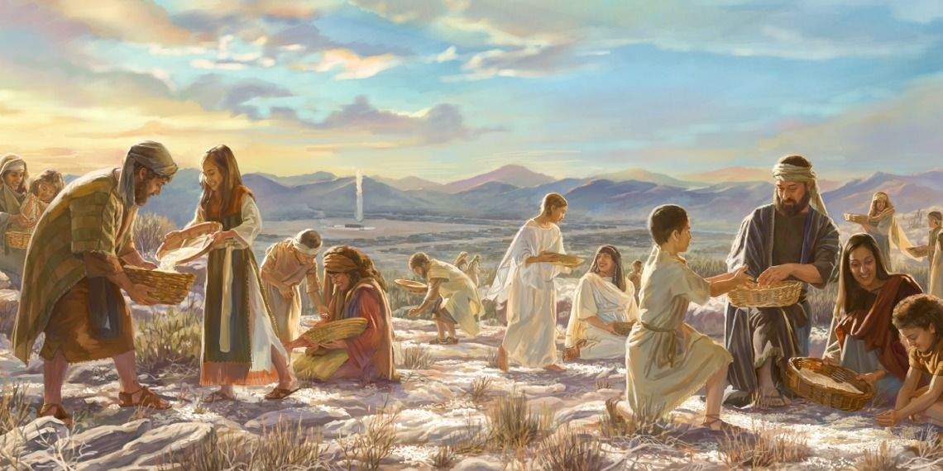
Pea naʻe folofola ai ʻa Sihova kia Mōsese, “Vakai, Te u fakaʻuha ʻae mā mei he langi maʻamoutolu: pea ʻe ʻalu atu ʻae kakai ʻo tānaki fakatuhotuha ki he ʻaho kotoa pē ʻae mā, koeʻuhi ke u ʻahiʻahiʻi ʻakinautolu, pe te nau felakaʻi ʻi heʻeku ngaahi fekau pe ʻikai. Pea ʻi hono ono ʻoe ʻaho ʻe fai pehē, te nau ngaohi ʻaia kuo na tuku, pea ʻe tuʻoua hono lahi hake ʻi he mā ʻoku nau ʻomi ʻi he ʻaho kehe.” … Pea naʻe ui hono hingoa ʻe he fale ʻo ʻIsileli, ko e Mana: pea naʻe hinehina ia ʻo hangē ko e tengaʻi kolianita; pea ko hono ifo naʻe hangē ha mā kuo ngaohi ʻaki ʻae honi.” Ekisotosi 16:4-5, 31
“Pea naʻa nau kai ʻae uite motuʻa ʻoe fonua ʻi he pongipongi ʻi he hili ʻa e kātoanga ʻoe Lakaatu, ko e mā taʻefakalēvani, mo e uite tunu ʻi he ʻaho pe ko ia.¶ Pea naʻe tuku leva ʻae mana ʻi he pongipongi hili ʻenau kai ʻae uite motuʻa ʻoe fonua; pea naʻe ʻikai toe maʻu ʻae mana ʻe he fānau ʻa ʻIsileli; ka naʻa nau kai ʻae fua ʻoe fonua ko Kēnani ʻi he taʻu ko ia.” Sosiua 5:11-12
Ko e Mana ko e Ma ʻo e Langi

Slide 14
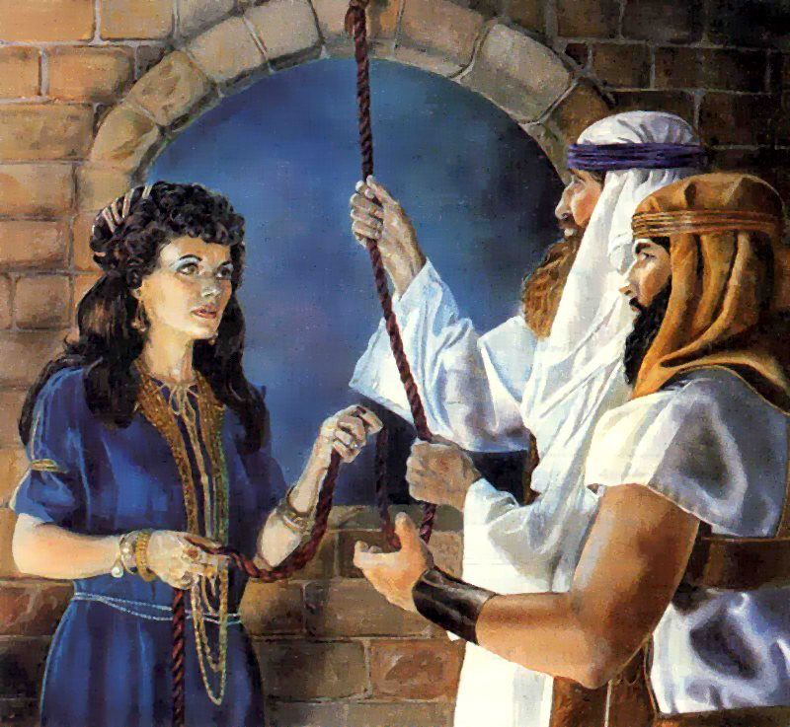

“Pea naʻe fekau ʻe Siosiua, ko e foha ʻo Nuni, ʻae ongo tangata mei Sitimi, kena fakaʻasiʻasi fakafufū pē, ʻo ne pehē, Mo ō ʻo vakai ʻae fonua, ʻio, ʻa Seliko. Pea naʻa na ō ʻo hoko ki he fale ʻo ha fefine angahala, naʻe hingoa ko Lehapi, pea na mohe ai.” Sosiua 2:1
“Pea naʻe folofola ʻa Sihova kia Mōsese, ʻo pehē, “Ke ke fekau ha kau tangata, ke nau ʻalu ʻo vakai ki he fonua ko Kēnani, ʻaia te u foaki ki he fānau ʻa ʻIsileli: ʻi he faʻahinga taki taha ʻo ʻenau ngaahi tamai ke mo fekau ha tangata, ʻoku taki taha matāpule ʻiate kinautolu.”Pea naʻe fekau ʻe Mōsese kiate kinautolu ʻi he fekau ʻa Sihova, mei he toafa ko Palani: ʻae kau tangata kotoa pē naʻe matāpule ʻi he fānau ʻa ʻIsileli.” Nōmipa 13:1-3
Naʻe fekauʻi atu ha kau faka’asi’asi ke kumi ʻa e fonua .

Slide 15
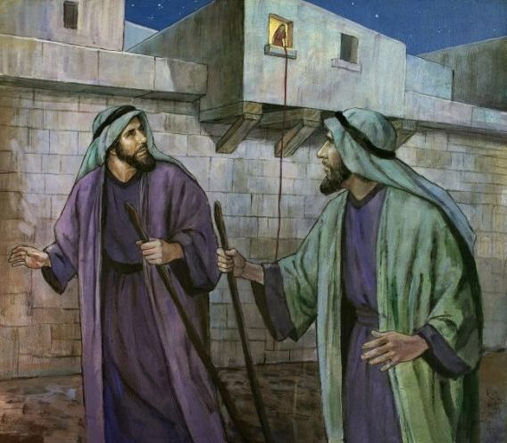
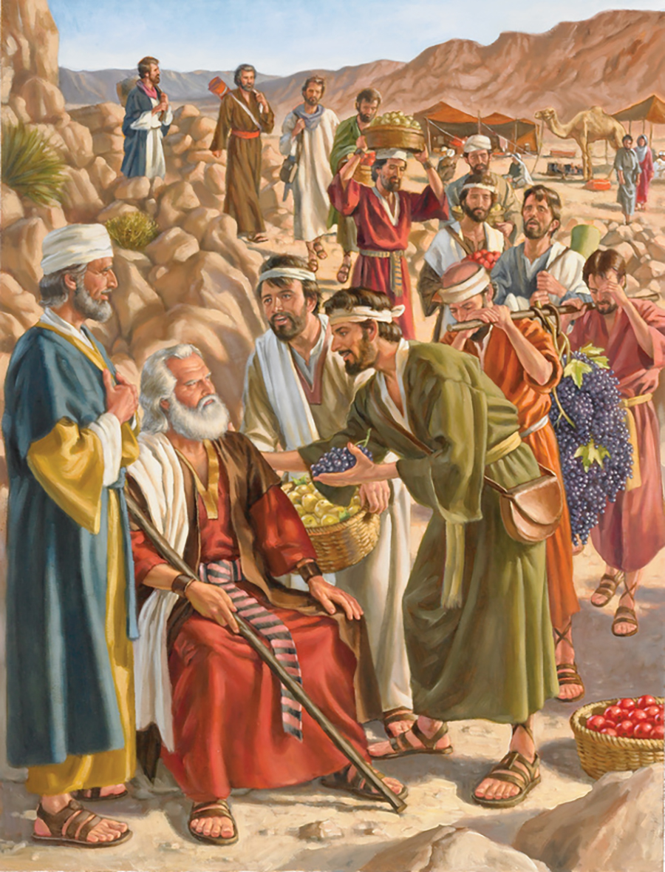
“Pea naʻa nau lea kiate ia, ʻo pehē, “Naʻa mau ō ki he fonua naʻa ke fekau ʻakimautolu ki ai, pea ko e moʻoni ʻoku pito ia ʻi he huʻahuhu mo e honi; pea ko hono fua eni. Ka ʻoku mālohi ʻae kakai ʻoku nofo ʻi he fonua, pea kuo ʻā maka ʻae ngaahi kolo, ʻo lahi ʻaupito: pea naʻa mau mamata ʻi ai ki he fānau ʻa ʻAnaki. ‌ʻOku nofo ʻi he potu fakatonga ʻoe fonua ʻae kau ʻAmaleki: pea ko e kau Heti, mo e kau Sepusi, mo e kau ʻAmoli, ʻoku nau nofo ʻi he ngaahi moʻunga: pea ko e kau Kēnani ʻoku nofo ʻakinautolu ʻo ofi ki he tahi, pea mo e matafonua ʻo Sioatani.” Pea naʻe lolomi ʻe Kelepi ʻae kakai ʻi he ʻao ʻo Mōsese, ʻo ne pehē, “Ke tau ʻalu hake ke vave, ʻo maʻu ia; he ʻoku tau mālohi lahi ke ikuna ia.” Ka naʻe pehē ʻe he kau tangata naʻa nau ʻalu hake mo ia, “ʻE ʻikai te tau mālohi ke ʻalu hake ki he kakai; he ʻoku nau mālohi ʻiate kitautolu.” Pea naʻa nau ʻomi ki he fānau ʻa ʻIsileli ʻae ongoongo kovi ʻoe fonua naʻa nau ʻalu ʻo vakai, ʻo pehē, “Ko e fonua naʻa mau ʻalu atu ke vakai ki ai, ko e fonua ia ʻoku ne keina ke ʻosi hono kakai; pea ko e kakai kotoa pē naʻa mau mamata ʻi ai ko e kau tangata lalahi ʻaupito. Pea naʻa mau mamata ʻi ai ki he kau tangata lalahi fakamanavahē, ko e ngaahi foha ʻo ʻAnaki ʻaia ʻoku tupu ʻi he faʻahinga lalahi: pea naʻa mau tatau ʻi homau mata ʻomautolu mo e fanga heʻe, pea naʻa mau pehē moʻoni ʻi honau ʻao ʻonautolu.” Nōmipa 13:27-33
Report of the Spies
“Ko ia naʻe liu mai ʻae ongo tangata ʻo ʻalu hifo mei he moʻunga, ʻo na ō ki he kauvai ʻe taha, ʻo hoko kia Siosiua ko e foha ʻo Nuni, ʻo fakahā kiate ia ʻaia kotoa pē kuo hoko kiate kinaua: Pea naʻa na pehē kia Siosiua, “Ko e moʻoni kuo tukuange ʻe Sihova ʻae fonua kotoa pē ki hotau nima; he ʻoku vaivai ʻae kakai kotoa pē ʻoe fonua koeʻuhi ko kitautolu.”.” Sosiua 2: 23-24

Slide 16
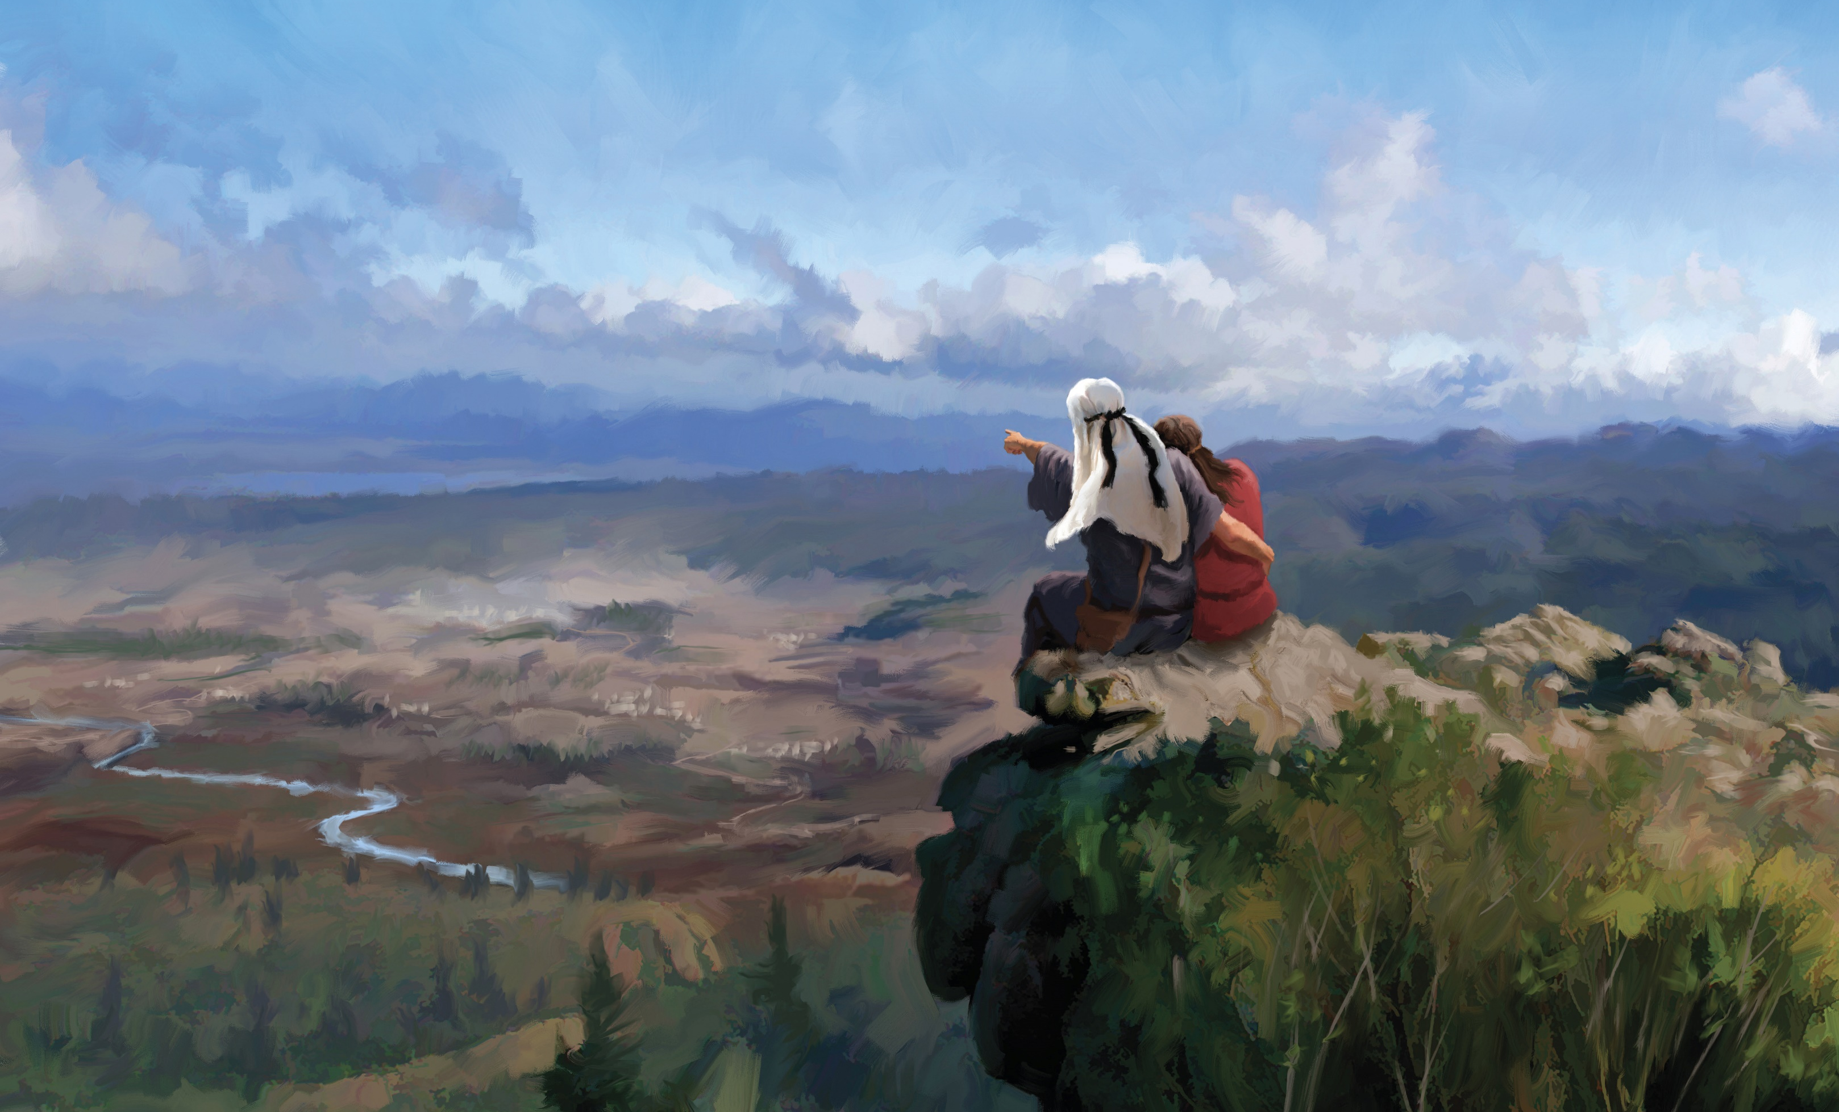
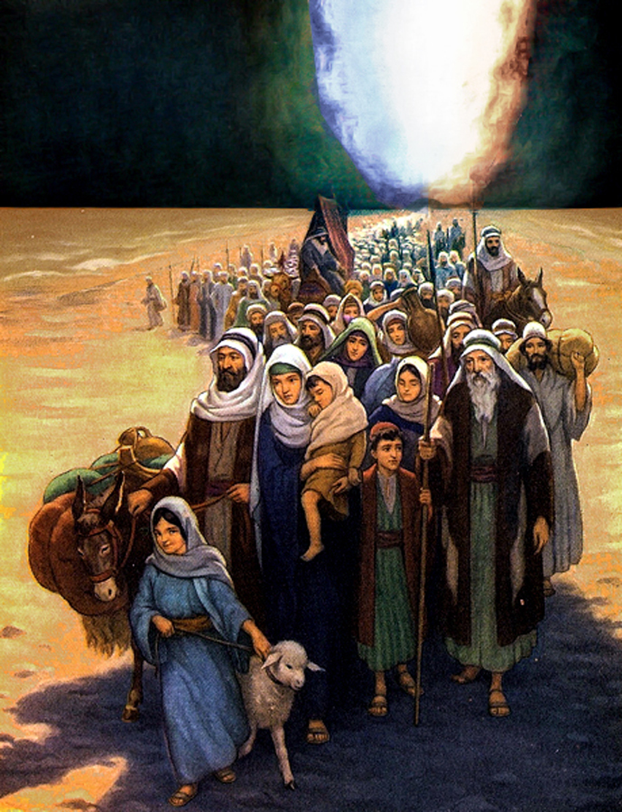
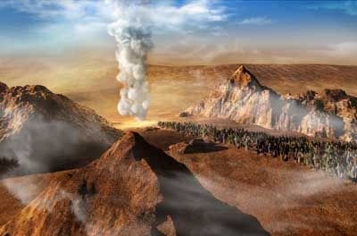
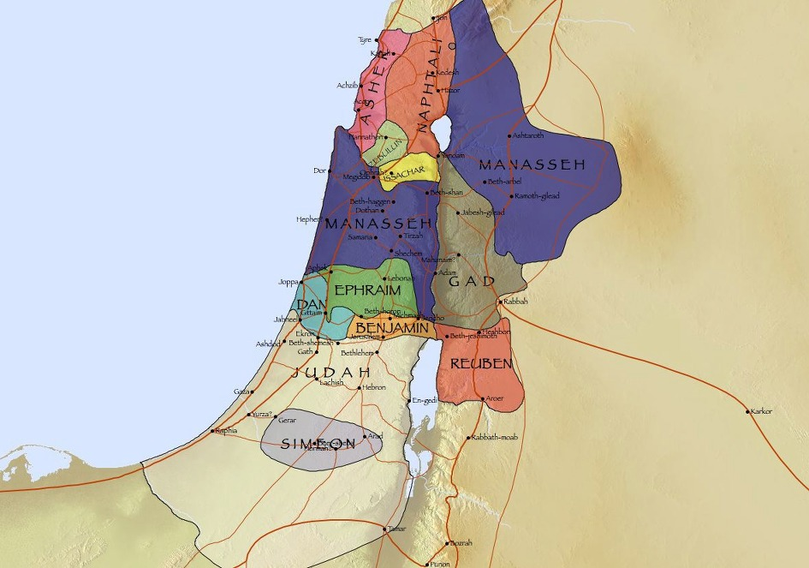
Ola ʻo e Tuʻutuʻuni
ʻIkai Maʻu ʻa e Kelekele mo e Mate: “Ke ke tala kiate kinautolu, ‘ʻOku pehē ʻe Sihova, ko e moʻoni ʻa ʻeku moʻui, pea te u fai kiate kimoutolu ʻo hangē ko hoʻomou lea ʻi hoku telinga: ‌ʻE tō homou ʻangaʻanga ʻi he toafa ni ʻakinautolu kotoa pē naʻe lau ʻiate kimoutolu, ʻo fakatatau ki homou lau kotoa pē, mei hono taʻu ʻe uofulu tupu, ʻakinautolu ʻaia kuo lāunga kiate au, Ko e moʻoni ʻe ʻikai te mou hoko atu ki he fonua, ʻaia ne u fuakava ke tuku kiate kimoutolu ke mou nofo ai, ka ko Kelepi ko e foha ʻo Sifune, mo Siosiua ko e foha ʻo Nuni. Ka ko hoʻomou fānau, ʻakinautolu naʻa mou pehē ki ai tenau pōpula, te u ʻomi ʻakinautolu ki ai, pea ʻe ʻilo ʻekinautolu ʻae fonua kuo mou liʻaki. Ka ko kimoutolu, ʻe tō homou ʻangaʻanga ʻi he toafa ni.”
Nōmipa 14:28-32
Maʻu ʻa e Kelekele:
“Ko ia naʻe kaila ʻae kakai ʻi he ifi ʻae meʻalea ʻe he kau taulaʻeiki: pea naʻe hoko ʻo pehē, ʻi he fanongo ʻae kakai ki he ifi ʻoe meʻalea, pea kaila ʻe he kakai ʻi he fuʻu kaila lahi, naʻe hinga lafalafa ʻae ā ki lalo, pea ʻalu hangatonu hake ʻae kakai ki loto kolo, ʻo ʻalu hangatonu atu ʻae tangata kotoa pē, ʻonau maʻu ʻae kolo…”
Sosiua 6:20-24

Slide 17
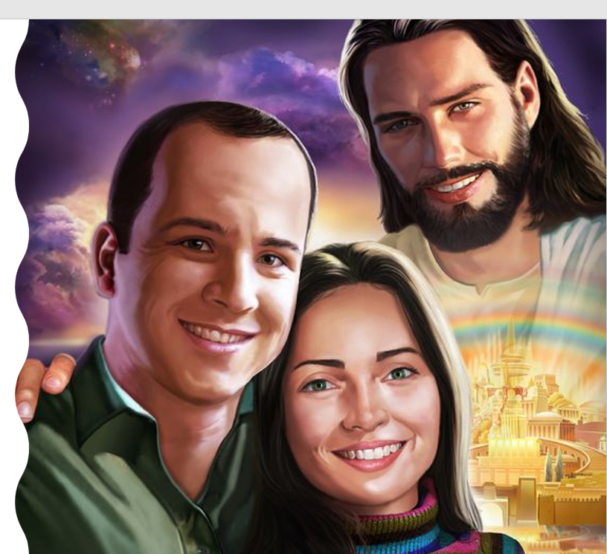
ʻOku tatau ʻa e ʻOtua ʻi he ʻaneafi, ʻaho ni, mo e ʻapongipongi. ʻOku Ne fakaha ia ki he toʻu tangata kotoa pe ʻa e tatau: ʻaloʻofa; faʻa kataki; ko e meʻa pe ia; ʻOku Ne fakahoko ha ngaahi mana; ʻOku ne fakamoʻoniʻi kitautolu...
ʻOku tau fili ke falala kiate Ia pe ʻikai, ʻo hange ko ia naʻe fai ʻe he kakai ʻo ʻIsileli.
Kapau te tau falala mo tuʻu maʻu ʻi Heʻene folofola, te tau aʻu ki he Fonua ʻo e Talaʻofa ʻoku mahutafea ʻi he huʻakau mo e hone. Te tau haʻu ʻo nofo ʻi he Kenani fakalangi, ʻa e mamani foʻou, pea te tau mamata ai ki he ngaahi meʻa kuo teʻeki mamata ki ai ʻa e mata, pe fanongo ki ai ha telinga, pe hu ki he loto ʻo e tangata.
ʻOku ou poupouʻi kimoutolu he ʻaho ni, ke tuku ke fakamaʻoniʻoniʻi kitautolu ʻe he ʻOtua, ke hokohoko atu hoʻomou falala ki Heʻene folofola, pea talangofua ki ai. Ko ia, ʻe vave ni pe haʻatau feʻiloaki ʻi Kenani Fakasilesitiale.

